Slide 1

IS 312 Web Design and Programing
Module 01 – Introduction Coding Env, HTML and CSS
School of Technology & Computing (STC)
City University of Seattle (CityU)

Slide 2
Beyond Simple Paragraphs
Inline Text Semantics
Emphasizing Content (<em> vs. <strong>)
Representing Technical Data(<code>, <pre>)
Notes:
Welcome back, everyone. Now that we understand the skeletal framework of a web page, we must look closer at inline text semantics. HTML isn't just about positioning text block primitives; it's about giving browser parsers explicit clues regarding content importance.

Slide 3
Structural Blockquotes and Citations
The <blockquote/> Container Layout
Inline Short Quotations( <q>)
Tracking Resources Attributions via <cite>
Notes:
When utilizing external source quotes, we use blockquotes for standalone multi-line shifts, which browsers default to indenting. For inline quotes wrapped directly inside regular paragraphs, we use the <q> tag, while passing the original work title inside a <cite> tag.

Slide 4
Code and Preformatted Data
Monospaced Font Rendering via <code>
Preserving Whitespace Layouts with <pre>.
Safely Escaping HTML Syntax Entities
Notes:
When writing software logs or math formulas, the browser normally condenses multiple spaces and line breaks into a single space. To prevent this, we wrap our code inside <pre> tags, which preserve every tab, break, and space exactly as typed in the file.

Slide 5
Micro – Semantics: Line Breaks and Horizontal Rules
Enforcing Text Wrapping via <br>
When to Avoid Break Overuse
The Thematic Section Break( <hr>)
Notes:
The <br> tag forces a line break within a single text block without creating a new paragraph unit. Use it for mailing addresses or poetry, not for forcing visual gaps. To mark a major thematic shift in the content, we use the horizontal rule <hr> tag.

Slide 6
The Anatomy of Hypertext
Anchors as the Internet’s Connective Tissue
The Crucial Role of href Attributes
Accessibility Traps: “Click Here” vs Descriptive Links
Notes:
Hyperlinks define the web. The anchor tag <a> requires a Hypertext Reference, or href, to target a location. For accessibility, your link text must describe the destination clearly; generic text like 'click here' prevents screen readers from understanding the destination out of context.

Slide 7
URL Structures:
Absolute vs Relative
Absolute Path:
  Referencing Global Domain
Relative Paths:
  Local Directory Traversal
Managing Moving Projects Files
Notes:
An absolute URL includes the protocol and domain (e.g., [https://site.com/page](https://site.com/page)), pointing to a specific location on the global web. A relative URL looks locally inside your folder structure. If you move project files around, relative links will break unless your directory structure matches exactly.

Slide 8
Internal Page Document Anchors
Targeting Elemet Identity Attributes
  ( id =“”)
Linking and Jumping in In-Page Content
  (#)
Optimizing Scroll Layout Workflows
Notes:
Links don't just point to other websites; they can navigate directly to specific sections on the same page. By adding a unique id attribute to an element, you can target it from an anchor tag by putting a hash symbol # followed by that element's ID inside the href attribute."

Slide 9
Alternative Link Protocols
Triggering Email Application
  (mailto:)
Initializing Phone Communication Routing
  (tel:)
The Security Impacts of
  target=“_blank”
Notes:
The href attribute supports communication protocols beyond standard HTTP. Prefixes like mailto: launch user email clients, while tel: initiates dialing protocols on mobile devices. When opening links in a new tab via target="_blank", remember to use security tags like rel="noopener" to isolate browser processes.

Slide 10
Image Formats and Use Cases
Raster Images vs. Vector Graphics
Standard Compressed Format:
  JPEG and PNG
Modern Web Optimization
  WebP and SVG
Notes:
Adding imagery requires balancing asset size with visual quality. JPEGs are best for complex photos, while PNGs support transparency for logos. Today, modern workflows favor WebP for superior data compression and SVGs for infinitely scalable vector graphics.

Slide 11
Then Multi-Attribute <img> Tag
The Self-Closing Tag Format
Sourcing the Image Pipeline (src=“”)
Enforcing Responsive Layout Proportions
Notes:
The <img> tag is a self-closing inline element that embeds an asset on your page. The src attribute holds the image file path. While you can specify pixel layout sizes directly using width and height attributes, modern practices use CSS rules to make images fluidly adjust across screens.

Slide 12
Alternative Text
Mandatory Accessibility Coverage (alt=“”)
How Screen Readers Handle Alt Data
Handling Decorative Images Correctly
Notes:
Every <img> tag must include an alternative text, or alt, attribute. If the image fails to load, or if a visually impaired user relies on a screen reader, this text serves as the content replacement. If an image is purely decorative, you still include the alt attribute, but leave it empty (alt="") so screen readers know to skip it entirely.

Slide 13
Structuring Figures and Captions
Isolating Media Collection via <figure>
Adding Visible Context Labels (<figcaption>)
Unifying Layout Elements
Notes:
To group images with a visible label or caption, HTML5 provides the <figure> and <figcaption> elements. Wrapping your asset in a <figure> block clearly marks the media as an independent content unit, while <figcaption> handles the accompanying label text.

Slide 14
Tabular Data Structures
When to Use Tables (Data vs Layouts)
Legacy Structure Exploitation Warning
The Core <table> Element Ecosystem
Notes:
Tables should strictly be used for organizing row-and-column tabular data, like financial reports or schedules. In the early days of web design, developers used tables to build page layouts, which severely compromised site accessibility and responsiveness. Today, layouts are handled entirely by CSS.

Slide 15
Rows, Headers, and Data Nodes
Setting up Horizontal Data Rows(<tr>)
Building Explicit Field Headers (<th>)
Populating Standard Cell Data Containers (<td>)
Notes:
A table is constructed layer-by-layer using rows. The <tr> tag defines a table row. Inside each row, you place individual cell nodes. We use <th> for top or side header labels—which render bold and centered by default—and standard <td> cells for the raw data values.

Slide 16
Advanced Structural Semantic Tables
Advanced Structural Semantic Tables
Document Description Summary Captions <captions>
Assisting Screen Reader Navigation Flows
Notes:
For complex datasets, you can split your table into semantic header, body, and footer sections using <thead>, <tbody>, and <tfoot>. Adding a <caption> tag right below the opening <table> tag provides an immediate textual summary, which is highly beneficial for both screen reader navigation and clear visual hierarchy.

Slide 17
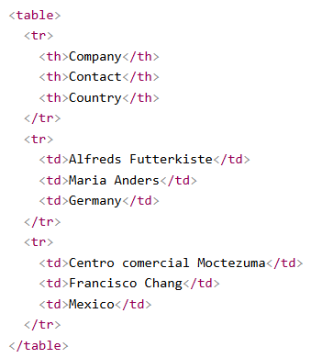

Basic Table Example

Slide 18
Collect User Input: Forms
The Core Form Wrapper System
  ( <form>)
Identifying the Action Backend Route
  ( action=“”)
Explicit Transmission Methods
  ( GET vs POST)
Notes:
Forms allow users to interact with your application by sending data back to a server. The <form> tag acts as the orchestrator. Its action attribute dictates the server-side URL destination path for processing, while the method attribute defines the transmission type—typically GET or POST.

Slide 19
Input Types and UI Controls
The Base Tag ( <input>)
Distinguishing Text Fields, Password and Checkboxes
The Vital Importance of Form Control Identity Tracking ( name=“”)
Notes:
The <input> tag changes its behavior entirely based on its type attribute. Setting it to text, password, checkbox, or radio alters the interface control element displayed to the user. Additionally, every input must have a unique name attribute, as this acts as the data key the backend server reads to parse the user's input.

Slide 20
Enhancing Connections with Labels
The Accessible Core Connector Element
The Explicit Identifier Match ( for=“” matches id=“”)
Expanding Click Target Boundaries
Notes:
Never leave form controls floating without clear text descriptions. The <label> element formally links a text description to an input control. By matching the label's for attribute to the input's unique id, you maximize screen reader accessibility and expand the click target area to include the text label itself.

Slide 21
Submission and Structured Controls
Dropdown and long text block ( <select>, <textarea>)
Bundling Options using <fieldset> and <legend>
Triggering Data Packaging Pipelines( type=“submit”)
Notes:
For complex inputs, use <textarea> for multi-line text and <select> for dropdown menus. You can bundle related inputs together visually and semantically using a <fieldset> container labeled by a <legend> caption. Finally, a button configured with type='submit' packages the user's inputs and sends them on their way to the server.

Slide 22
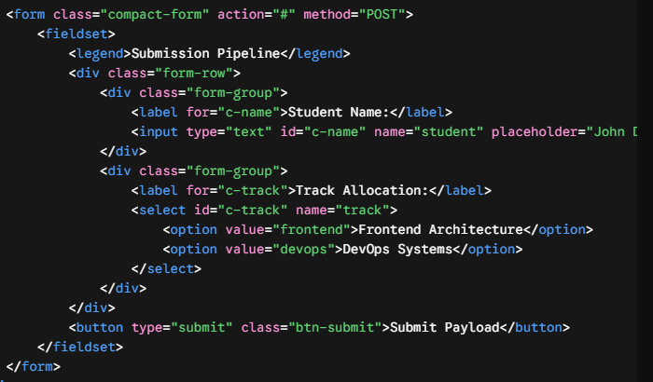
Form Example

Slide 23


Q&A

